Slide 1
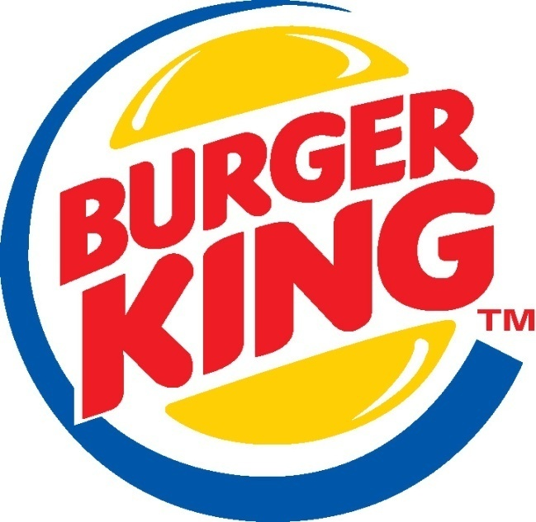
BURGER KING – ANALYSIS OF SERVICE BRAND
Course: Managing Service Success
Ajay Mutgekar
Animesh Tamrakar
Pratik Singh
Balaji G. S.

Slide 2
Fast Food Restaurants in India: Overview
Indian fast food market is expected to grow at a CAGR of 18% by 2020.
Fast food market in India is expected to be worth US$ 27.57 billion by 2020. About 10% of the fast food market in India is organized.
Organized fast food market in India is expected to grow at a CAGR of 27% by 2020.
The QSR’s (Quick Service Restaurants) and the casual dining restaurants together constitute over 74 percent of the market and are growing exponentially.
Quick Service Restaurants (QSRs) market in organized fast food sector in India is projected to grow at a CAGR of 20% by 2019-20.

Slide 3
Burger King: Introduction
Global chain of hamburger fast food restaurants headquartered in Florida, US.
Most Burger King Restaurants are franchises –
a local owner owns the restaurant. The owner pays Burger King to use the Burger King name on the restaurant. In addition, the owner also pays a percentage of the profits to Burger King.
Burger King mostly follows the Master Franchise. A master franchise is a franchising contract in which the master franchisor (the owner of the brand name) hands over the control of the franchising activities in a specified territory to a person or entity, called the ‘master franchisee’.
Burger King’s main product lines are as follows: Burgers; Chicken and fish; Sides; Salads and veggies; Beverages; Sweets/Desserts.

Slide 4
Driver of Customer Satisfaction
Dimension | Variable | Definition
Facilities | Internal and external appearance (colors, design, decoration) Comfort Cleanliness Location | Physical characteristics that the customer perceives at a glance such as: colors, decoration and design. Comfortable furniture and spaces. Cleanliness in facility and tableware. Easiness to reach the restaurant.
Accessibility | Parking Lot Payment alternatives Courtesy and welcome Proficiency and ability | Easiness and safe car parking. Payment alternatives and facilities Welcome greetings received by customers Personnel’s level of knowledge of the food.

Slide 5
Driver of Customer Satisfaction…
Personal | Presentation Promptness Empathy | Personnel appearance. Personnel level of proficiency to attend customers’ needs. Perception of familiarity, needs’ understanding, reliability, attitude.
Environment | Audiovisual Ambiance Lighting Smells Room temperature Aroma Variety | Background music, TV programs. Lighting according to the type if restaurant. Smells perception at the moment of arrival. Room’s temperature is manipulated for more comfort. Perception of a pleasant aroma. Options to choose.

Slide 6
Driver of Customer Satisfaction…
Food | Taste Presentation Food hygiene Food freshness Temperature Prestige | Food and beverages must have a pleasant taste. Food visually attractive Foods look clean and disinfected. Foods with a pleasant appearance and keeping its natural properties. Foods with the proper temperature Clients’ perception of a restaurant with a prestige.
Consistency and Honesty | Accomplishment Attention to complaints | The clients received what they ordered and have in inventory what is offered. Fast and adequate solution to client’s complaints.

Slide 7
Interview Highlights
Majority of customers are captive from nearby area
Very less customers in a joint are from outside of that area
If the Burger King outlet is in a mall then customer base is directly impacted due to popularity of the mall
Customers are not looking to spend a big amount and consider Burger King as a relatively value for money restaurant
Frequently visited by youngsters, with limited money to spend, with their friends
Families with kids are likely to visit often as children get gravitated towards fast food
Professionals having lack of time visit often to get food quickly
People looking for a quick snack in-between meals tend to visit more

Slide 8


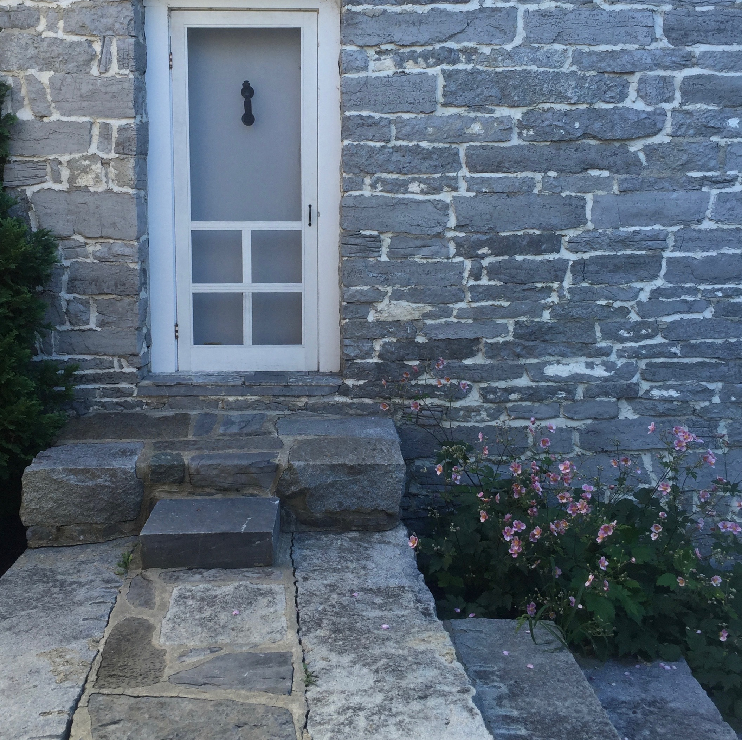

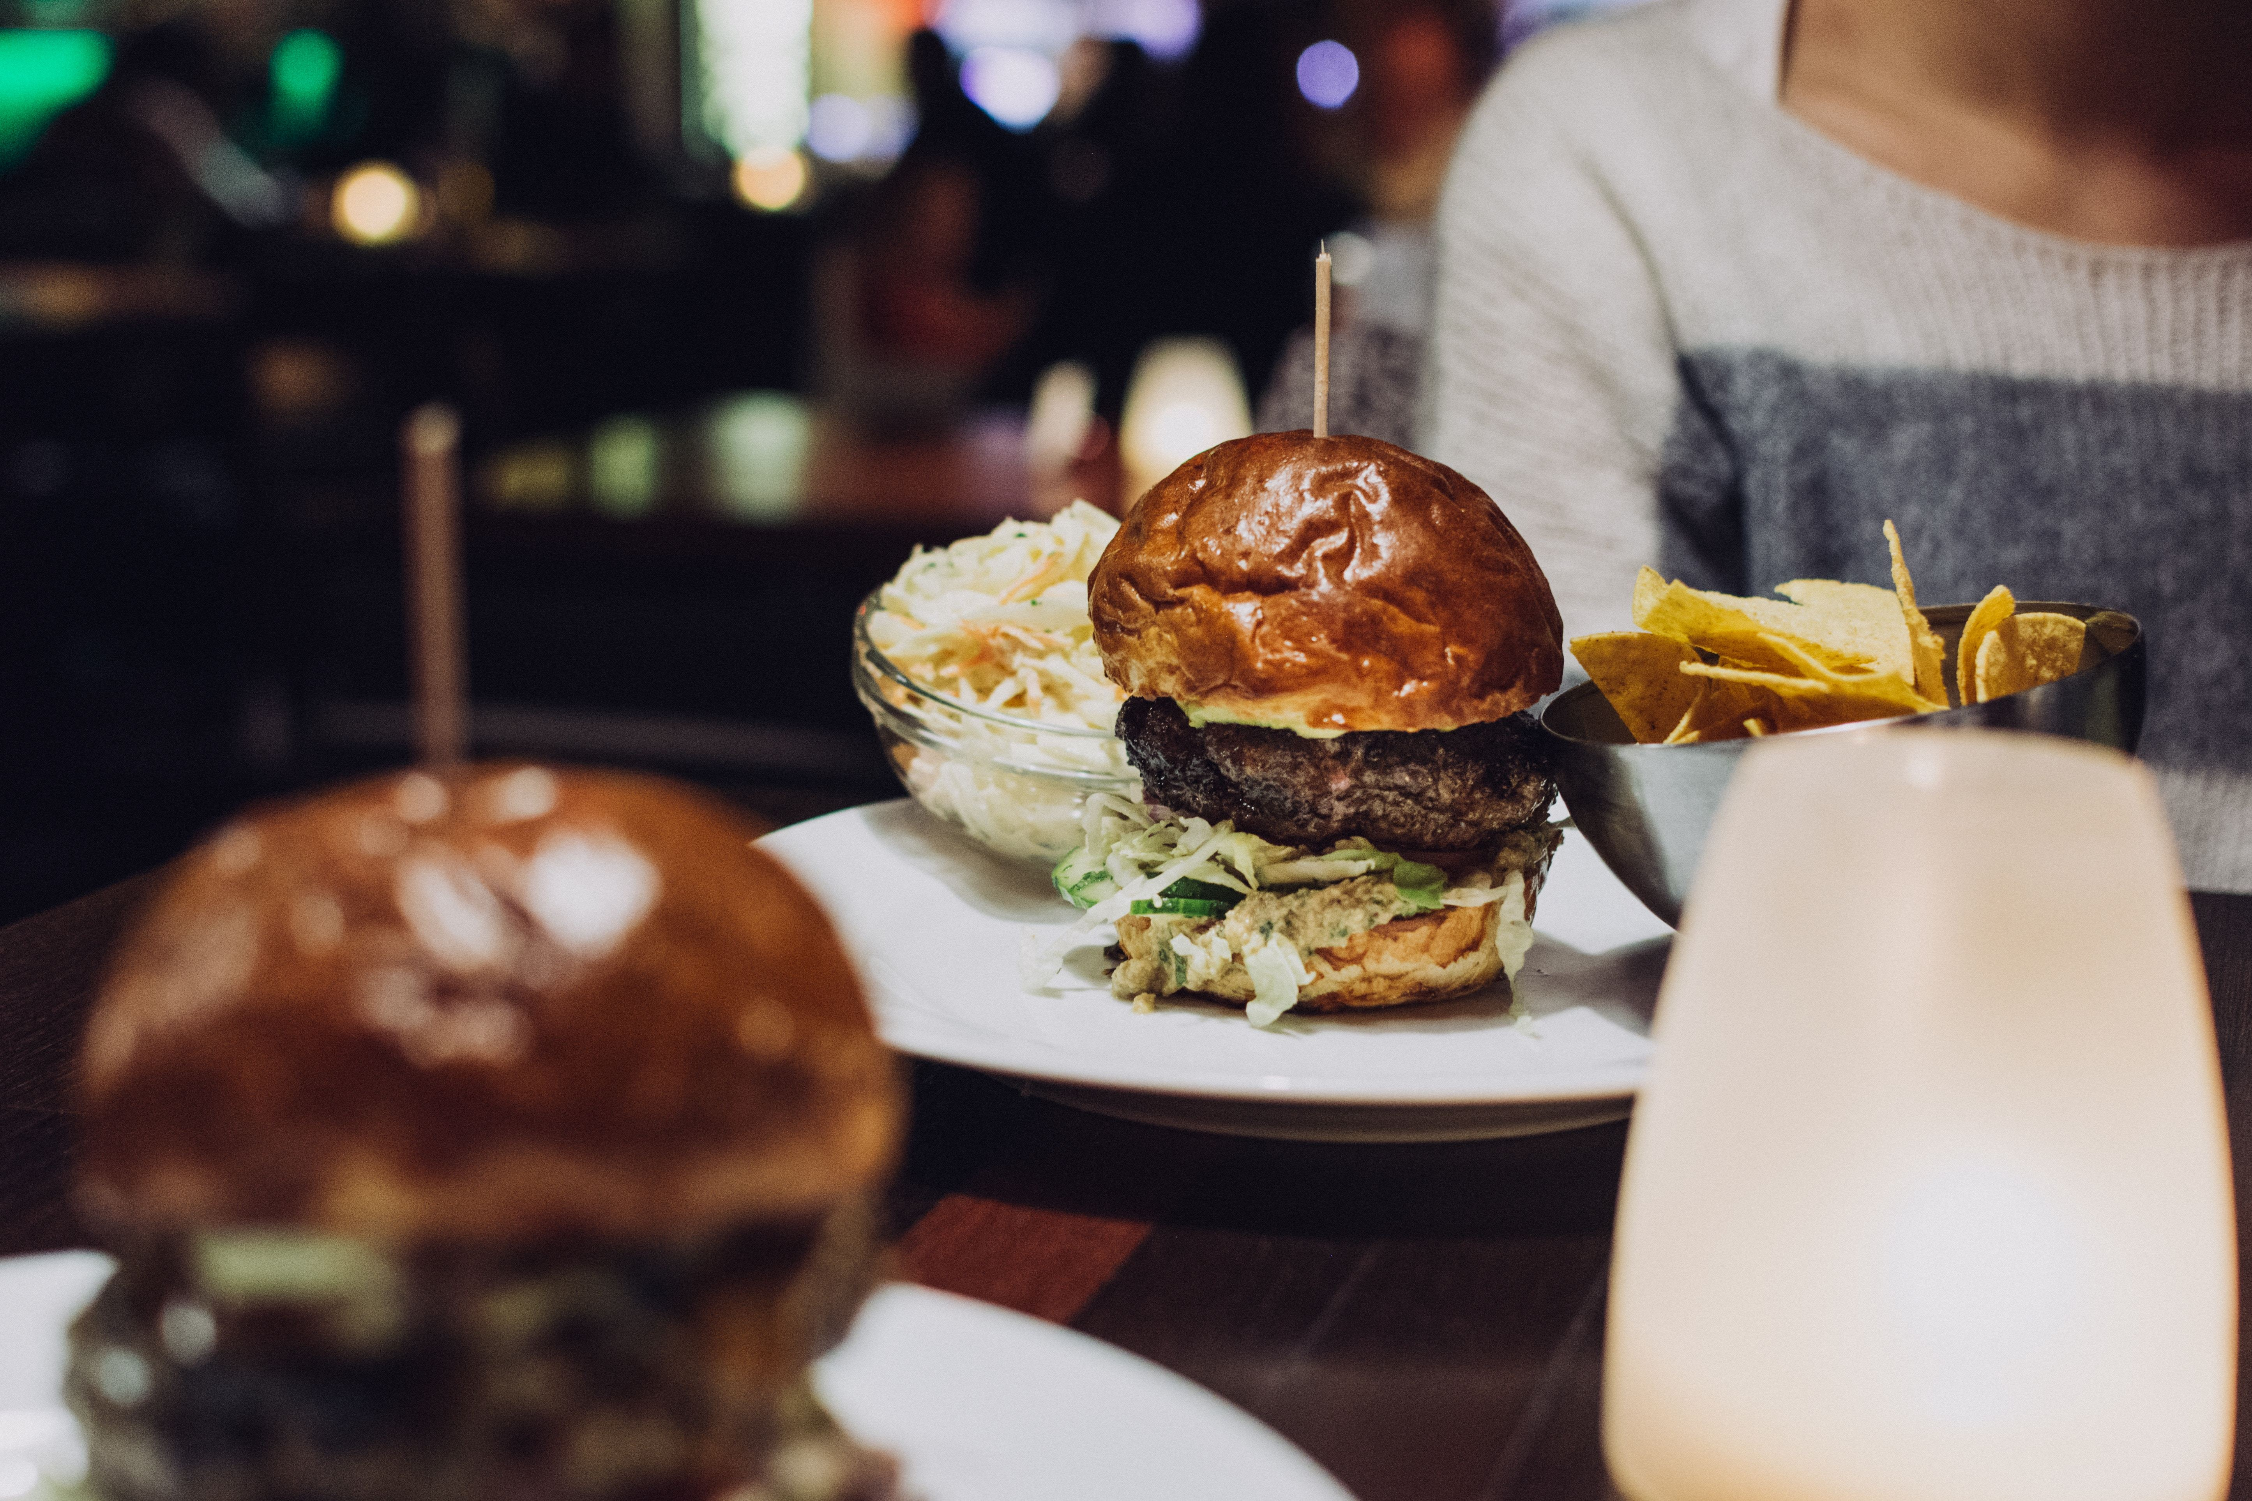
Ayush
Should provide quality service
Shouldn’t need to wait long for order
Expects consistent taste
Cannot compromise with cleanliness
Menu with variety of options to pick from and should know what to expect
Burger King: Persona
Expectations from restaurant
31
Ayush spends quite a bit of time in office, working on projects with tight deliverables. He has a big team to handle and has multiple stakeholders. He is usually pressed for time. Consumes media online via web, mobile and television. He likes travelling, listening to music and is a millennial. He usually eats home cooked food but feels the urge towards fast-food every once in a while.
Age and gender
Description
Indian
Nationality
Married
Marital state
Cell Phone: Carries an iPhone X
Prefers to consume media on the go
Would like to see menu online
Finds it convenient to pay using mobile wallet
“No time to wait!!“ Get Things Done Fast!!
Service
What are her technology habits?
Quote
Occupation
Mood images
Expects instant gratification during consumption of service. Would like to get his order placed and served quickly and expects a satisfying meal with consistent taste every time he comes. Would like to see new options to choose from in the menu every once in a while
What is her overall goal when trying to use our service?

Slide 9



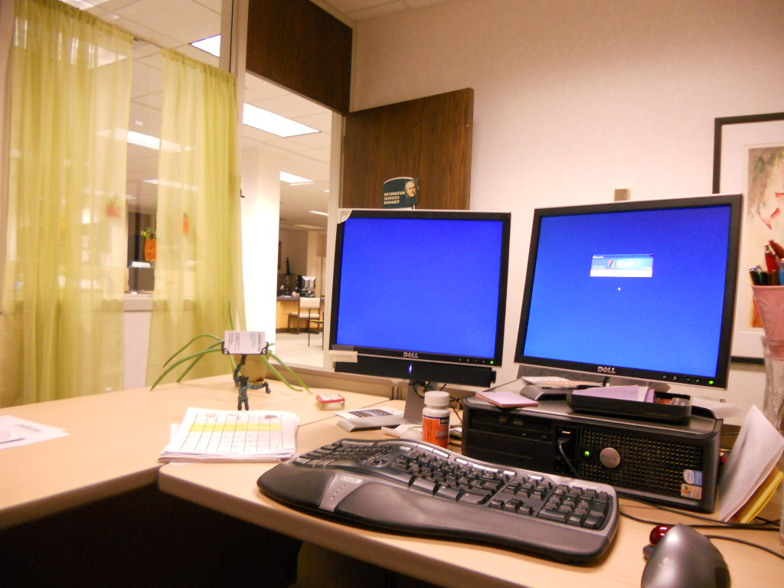
Ayush
Burger King
Ayush’s Burger King Journey
Ayush gets up from his desk in office during lunch time
Emotional journeys
Dramatic arc
Channel Overview
Line of Visibility
Ayush gets up from his office desk during lunch time. He has a meeting to attend in the next half an hour and needs to grab quick lunch. He decides to head to Burger King in food court downstairs
Mobile App
Webpage
Ayush’s detailed description
Backstage Lane
Office to elevator
Waits till he reaches counter
Order food, collect and eat
Back to office

Slide 10
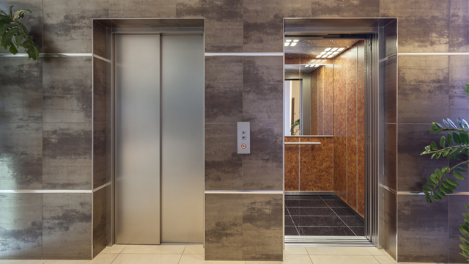
Ayush
Burger King
Ayush’s Burger King Journey
He gets into the elevator
Emotional journeys
Dramatic arc
Channel Overview
Line of Visibility
He gets into the elevator that takes him to ground floor where food court is located. Food court is in the common area accessible to outside crowd as well along with professionals in tech park
Mobile App
Ayush’s detailed description
Backstage Lane
Office to elevator
Waits till he reaches counter
Order food, collect and eat
Back to office

Slide 11

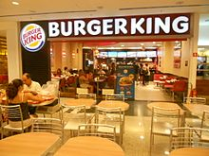
Ayush
Burger King
Ayush’s Burger King Journey
Reaches Burger King outlet
Emotional journeys
Dramatic arc
Channel Overview
Cashier
Server
Table Cleaning Crew
Line of Visibility
Burger King is the first outlet in food court. He can see the outlet from the moment he enters the food court.
Mobile app
Ayush’s detailed description
Backstage Lane
Office to elevator
Waits till he reaches counter
Order food, collect and eat
Back to office

Slide 12
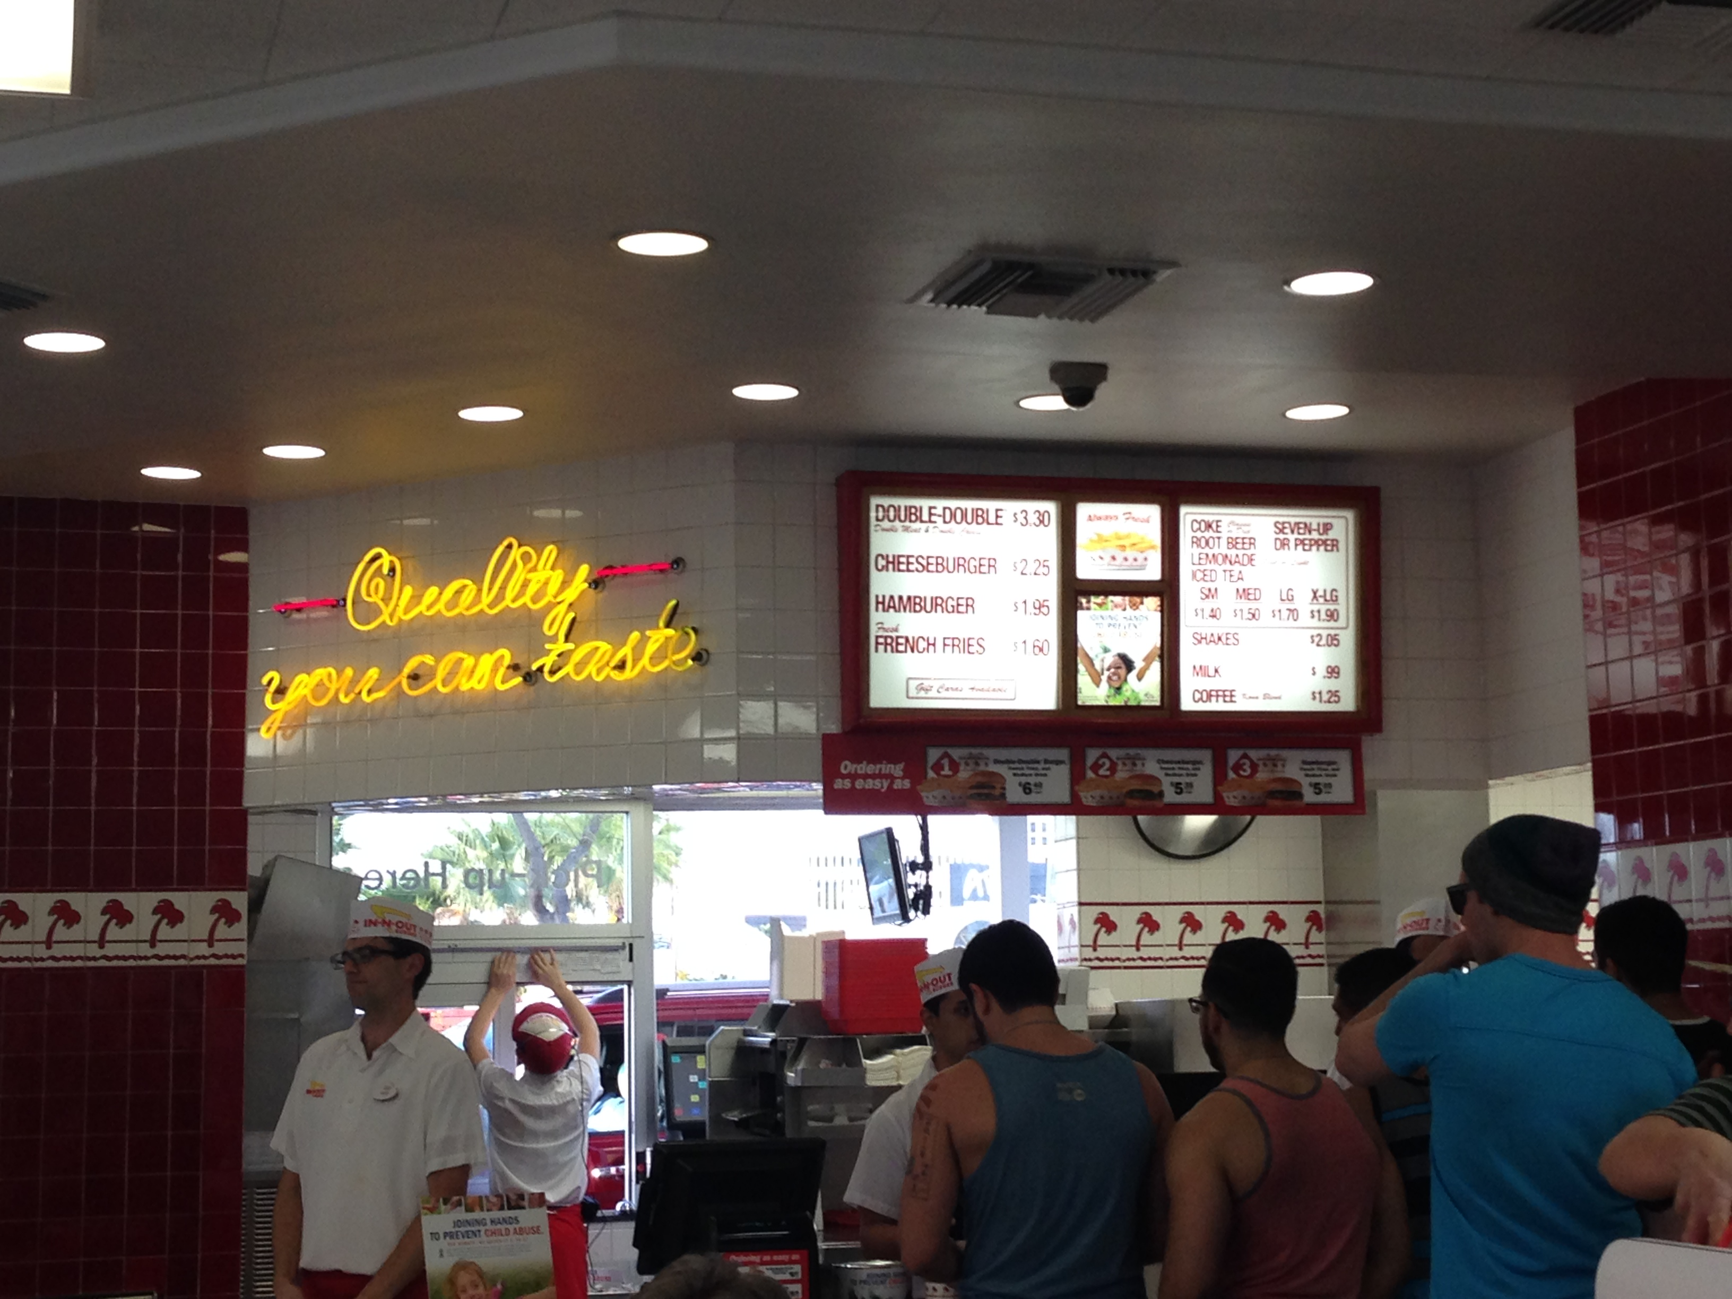
Ayush
Burger King
Ayush’s Burger King Journey
Gets into the queue
Emotional journeys
Dramatic arc
Channel Overview
Cashier
Server
Table Cleaning Crew
Cook
Line of Visibility
Fiddles with his cellphone and looks at the boards behind billing counter showing menu options
Mobile app
Ayush’s detailed description
Backstage Lane
Office to elevator
Waits till he reaches counter
Order food, collect and eat
Back to office

Slide 13
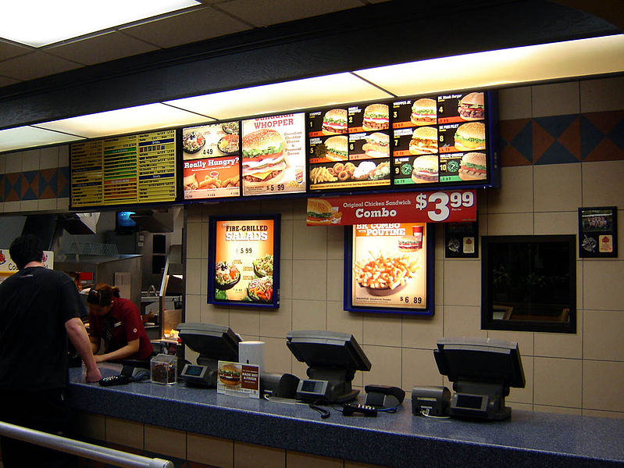
Ayush
Burger King
Ayush’s Burger King Journey
Picks what to order while being in queue
Emotional journeys
Dramatic arc
Channel Overview
Cashier
Server
Table Cleaning Crew
Cook
Line of Visibility
Picks the items to order by looking at the menu options displayed. His decision is impacted by his old orders and also on the basis of pictures displayed
Mobile app
Ayush’s detailed description
Backstage Lane
Office to elevator
Waits till he reaches counter
Order food, collect and eat
Back to office

Slide 14

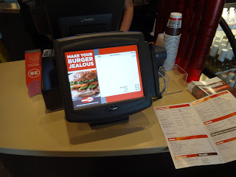
Ayush
Burger King
Ayush’s Burger King Journey
Places an order
Emotional journeys
Dramatic arc
Channel Overview
Cashier
Server
Table Cleaning Crew
Cook
Line of Visibility
Speaks with the person on the counter and places the order. He gets few recommendations from the person and decides to go with a combo
Cashier
Ayush’s detailed description
Backstage Lane
Office to elevator
Waits till he reaches counter
Order food, collect and eat
Back to office

Slide 15
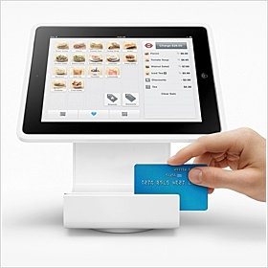
Ayush
Burger King
Ayush’s Burger King Journey
Makes payment and collects invoice
Emotional journeys
Dramatic arc
Channel Overview
Cashier
Server
Table Cleaning Crew
Cook
Line of Visibility
Makes the payment through his credit card. The transaction is quick and easy as it is done using a wireless credit card and the billing amount is under limits. No PIN is needed.
Cashier
Server
Cook/Preparer
Table Cleaning Crew
Ayush’s detailed description
Backstage Lane
Office to elevator
Waits till he reaches counter
Order food, collect and eat
Back to office

Slide 16
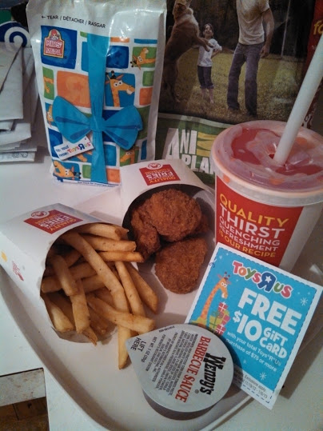
Ayush
Burger King
Ayush’s Burger King Journey
Collects food
Emotional journeys
Dramatic arc
Channel Overview
Cashier
Server
Table Cleaning Crew
Cook
Line of Visibility
The helper behind the person taking the order quickly puts together the ordered items and puts them all on a tray that is picked by Ayush
Cashier
Server
Table Cleaning Crew
Ayush’s detailed description
Backstage Lane
Office to elevator
Waits till he reaches counter
Order food, collect and eat
Back to office

Slide 17
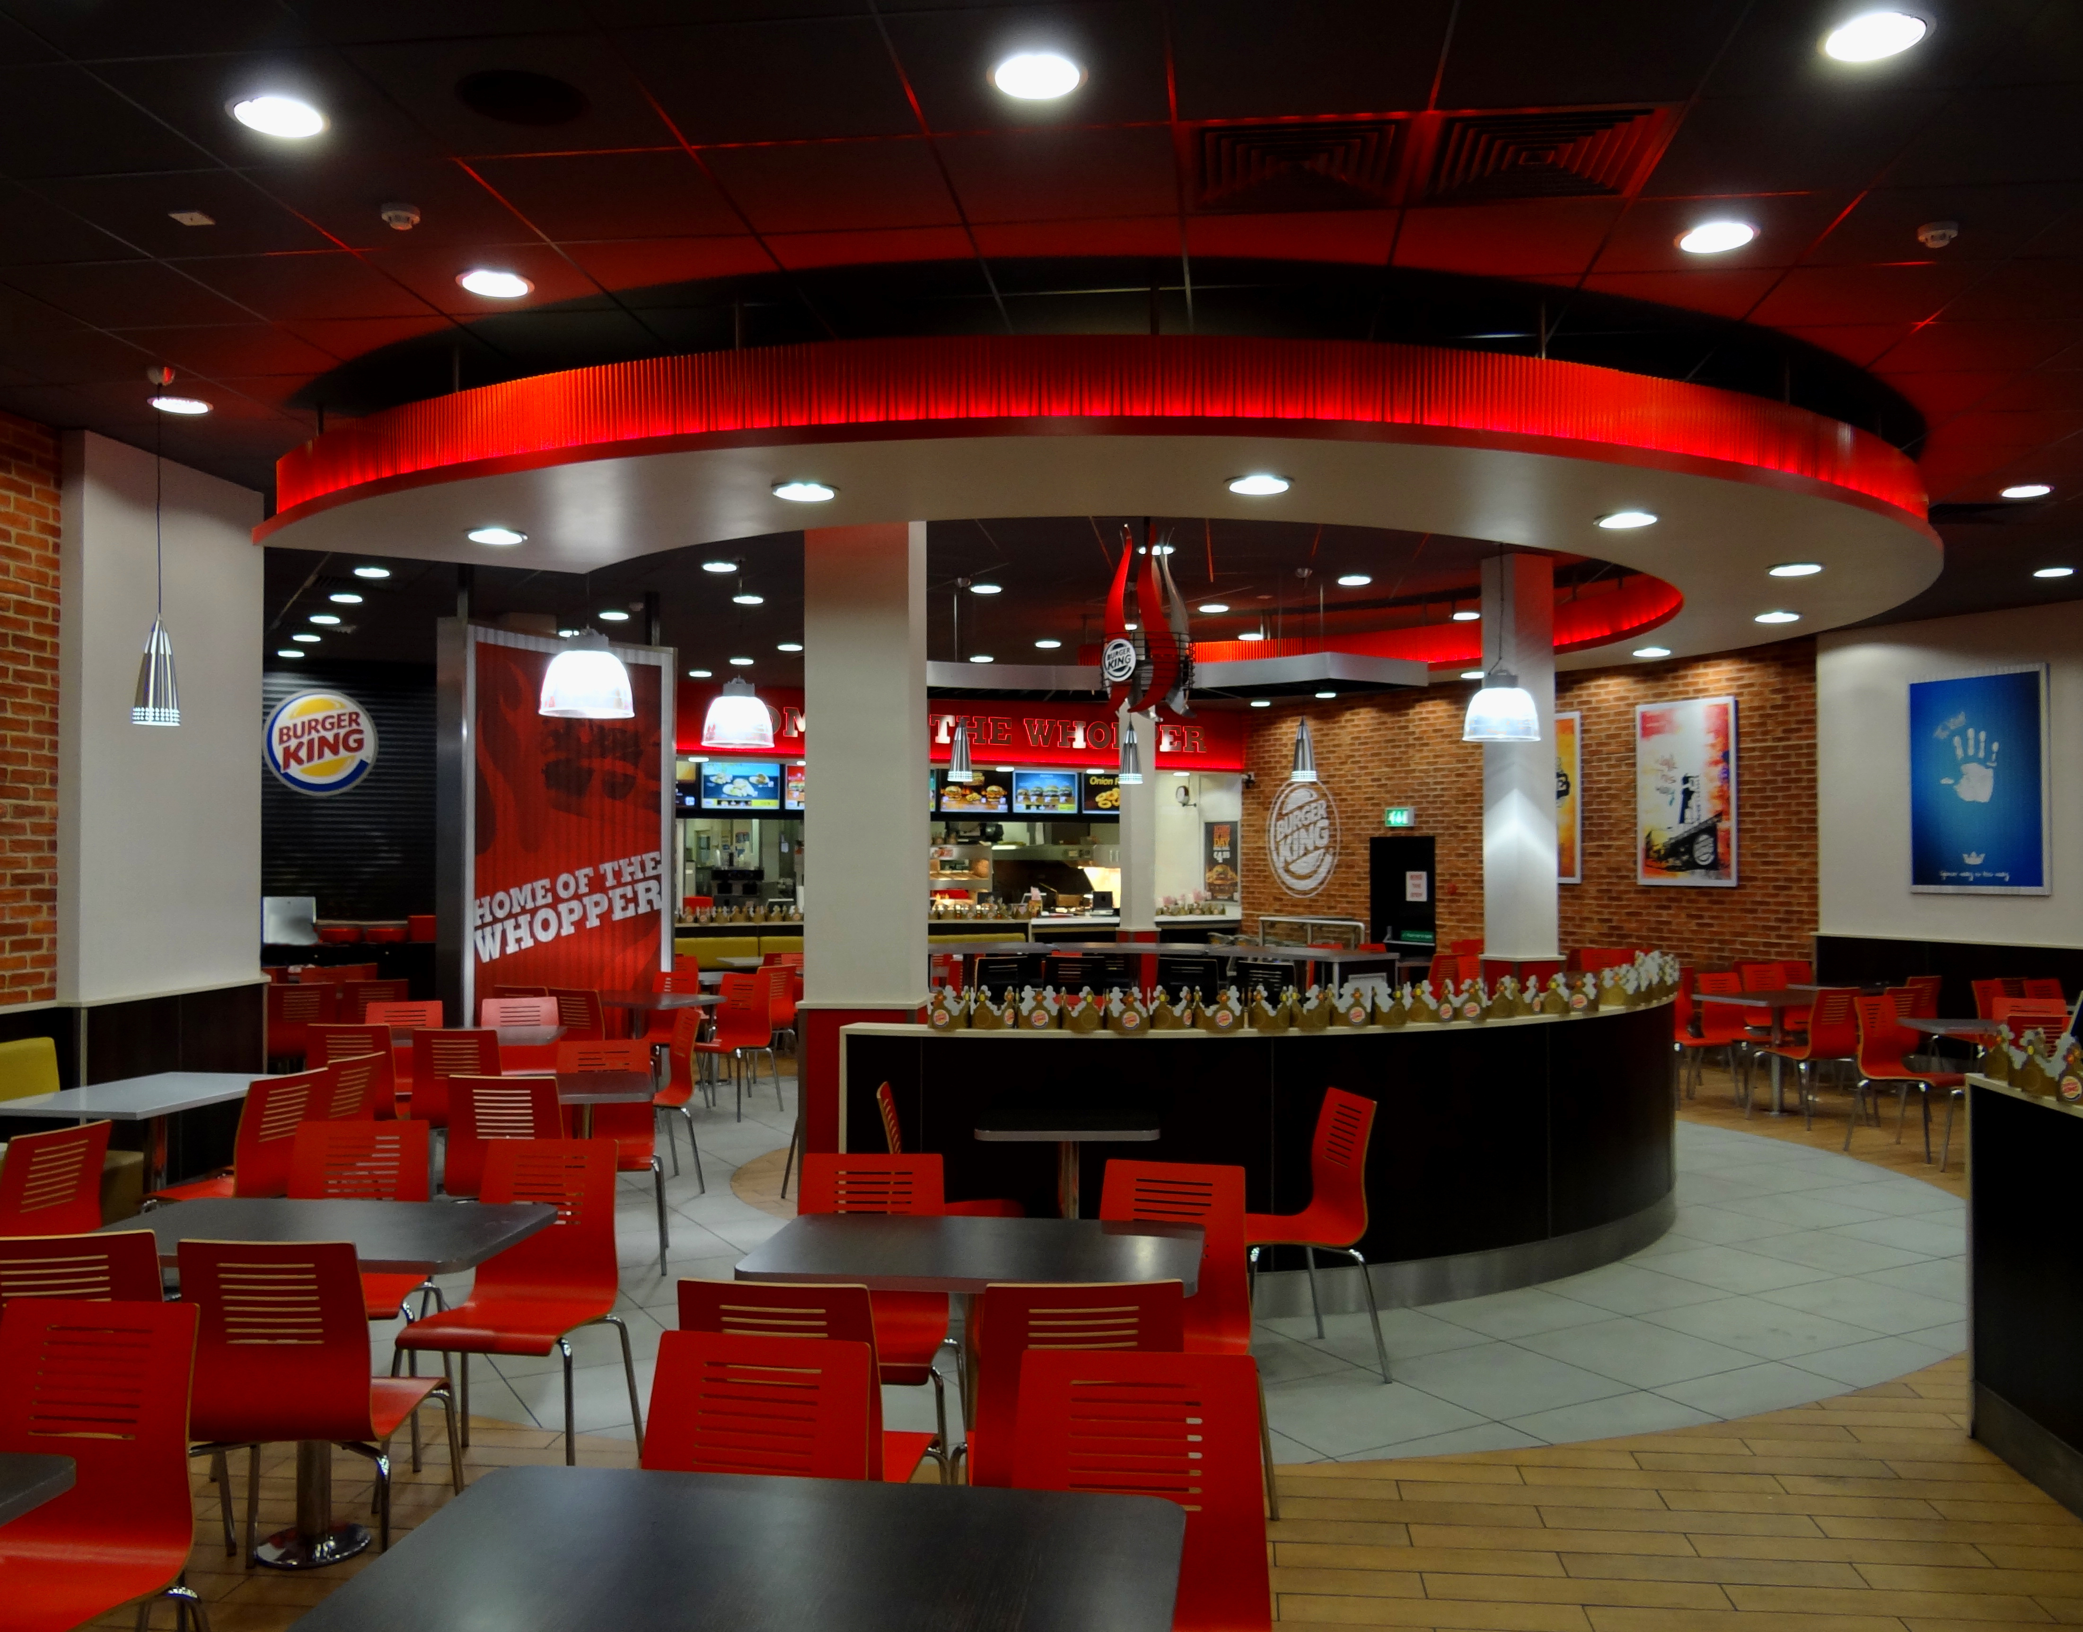
Ayush
Burger King
Ayush’s Burger King Journey
Gets seated on a table
Emotional journeys
Dramatic arc
Channel Overview
Table Cleaning Crew
Line of Visibility
Ayush finds an empty table amongst many. Gets seated on the one facing towards exit, opposite to billing counter
Table Cleaning Crew
Ayush’s detailed description
Backstage Lane
Trip From Denver to Paris (17 hours)
Waits till he reaches counter
Order food, collect and eat
Back to office

Slide 18
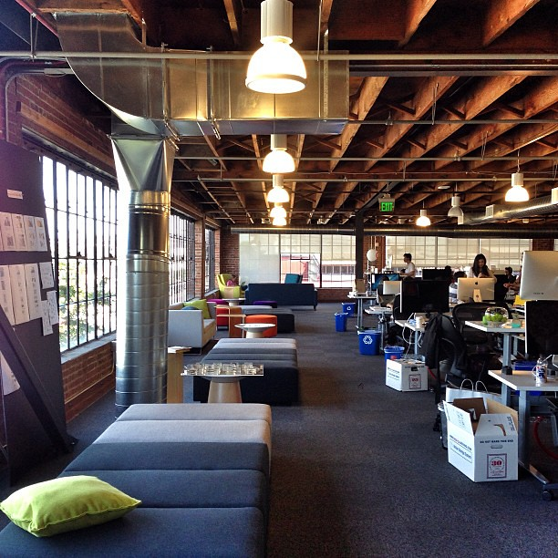
Ayush
Burger King
Ayush’s Burger King Journey
Finishes meal and is on the move again
Emotional journeys
Dramatic arc
Channel Overview
Table Cleaning Crew
Line of Visibility
Finishes his meal and heads with his tray towards tray deposit area. He will wash his hands and will start back for his office desk
Table Cleaning Crew
Ayush’s detailed description
Backstage Lane
Office to elevator
Waits till he reaches counter
Order food, collect and eat
Back to office

Slide 19
Service Quality Measurement
Service Quality is the customer’s perception about the superiority in the service received, containing two dimensions, the “intangibles” and the “tangibles.
For measuring service quality in this study, we have used the survey questionnaire instrument to measure responses of diners on the SERVQUAL scale.
Survey Link - https://forms.gle/PLwg1xQEBfBATeFC8.
The survey questionnaire had questions along the 5 dimensions of SERVQUAL – Tangibility, Reliability, Responsiveness, Assurance and Empathy.

Slide 20

SERVQUAL of Burger King - TANGIBLES
measures the comfortable seating arrangement of diners, aesthetic appeal of the outlet including the music volume, cleanliness of cups, saucers, plates, and cleanliness maintained by staff.

Slide 21
SERVQUAL of Burger King - RELIABILITY
measures the ability of Burger King and its employees to provide right food at the right time as promised consistently, whether they keep record of their regular diners and their preferences, the quality of food delivered as promised.

Slide 22
SERVQUAL of Burger King - RESPONSIVENESS
measures whether Burger King employees inform the diners about the time to prepare & serve food, whether a genuine intent is shown to help diners, and they are not made to wait for long periods unnecessarily.

Slide 23
SERVQUAL of Burger King - ASSURANCE
measures whether Burger King and its employees have knowledge and skills to answer diners’ queries, give enough information to customers to let them know of the safety standards followed during procuring of ingredients as well as during preparation of food.

Slide 24
SERVQUAL of Burger King - EMPATHY
measures whether Burger King and its employees have knowledge and skills to answer diners’ queries, give enough information to customers to let them know of the safety standards followed during procuring of ingredients as well as during preparation of food.

Slide 25
SERVQUAL vs Satisfaction
The overall average score for SERVQUAL for Burger King stood at negative 0.26.

Slide 26
Net Promoter Score
Net Promoter Score (NPS) was also determined from the questionnaire by asking the respondents on their overall satisfaction for Burger King.
The overall average value of NPS is also rather disappointing at 6.55 on a scale of 10, which is below the ideal score of 9 or 10.

Slide 27
Impact of Service Quality & Customer Satisfaction on Customer Loyalty
The customer’s perceived service quality and his overall satisfaction has a bearing on the customer loyalty.
The overall average word-of-mouth communication stands at a disappointing value of 6.74 on a scale of 10, again below ideal score of 9 or 10.
Overall Satisfaction equation derived from regression analysis:-
Overall Satisfaction = 6.06157556244388 + 1.33801046219334 * Tangible -1.37714350755589 * Reliability + 0.759144653382331 * Responsiveness + 0.373010966659283 * Assurance + 0.237345218387662 * Empathy

Slide 28

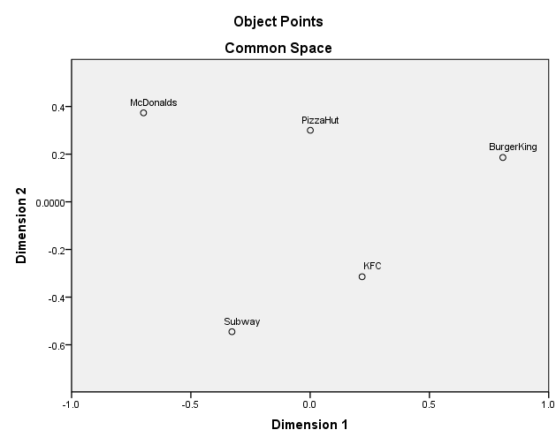
Mapping Competitive Positioning
“McDonalds”, “KFC”, “Burger King”, “Subway” and “Pizza Hut” were rated on a scale of 1 (Least Similar) to 10 (Most Similar) as per their past experience.

Slide 29
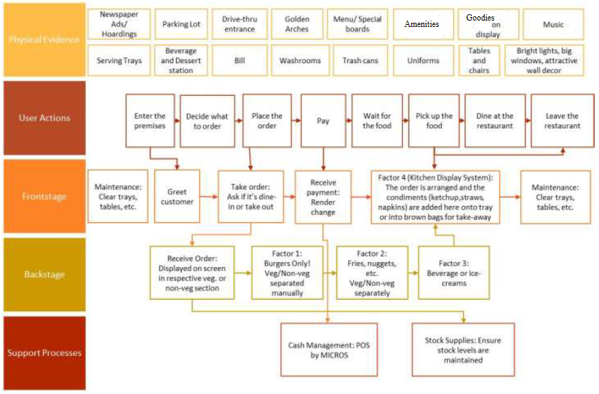
Service blueprint

